Slide 1

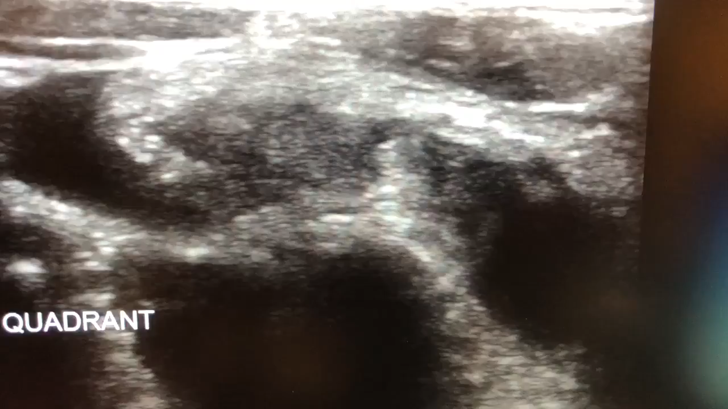
Appendicitis Point of Care Ultrasound

Slide 2
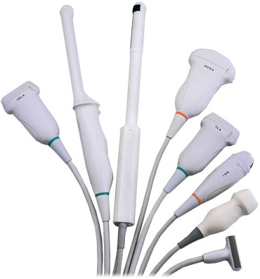

Objectives
Indications for Appendix POCUS
Transducer Selection
RLQ Anatomy
Ultrasound findings in appendicitis

Slide 3


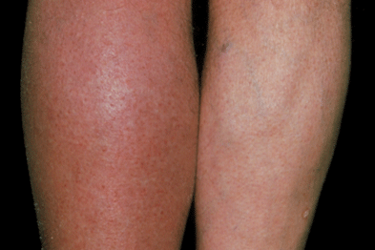

Indications for DVT POCUS
Leg Pain
Leg Swelling
Erythema
Chest Pain/SOB

Slide 4
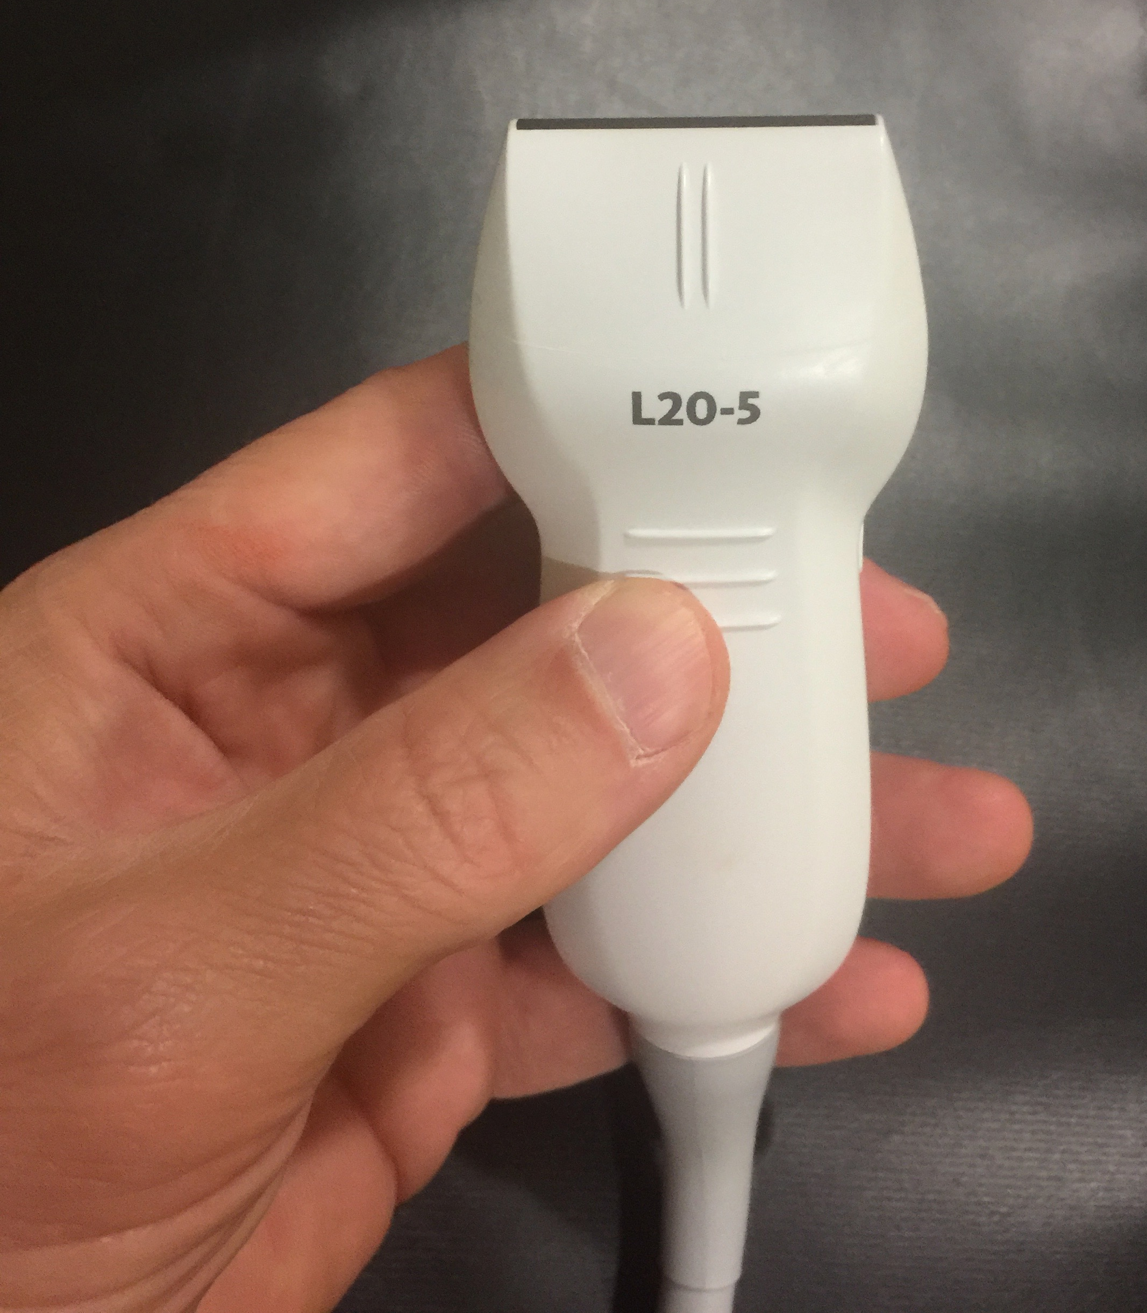
Transducer Selection

Slide 5
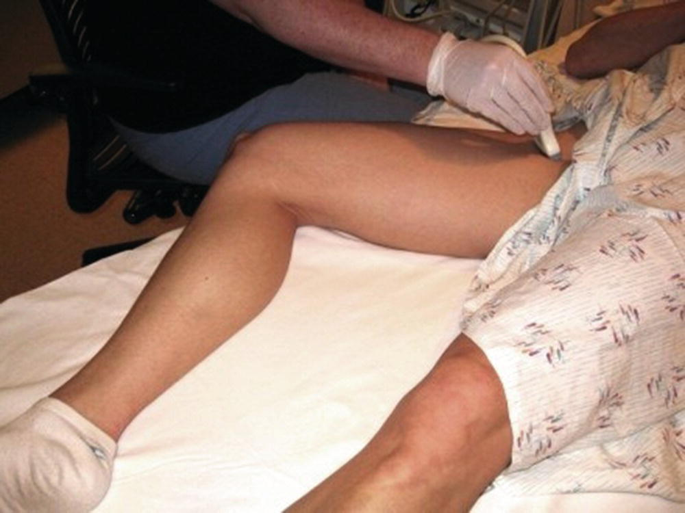
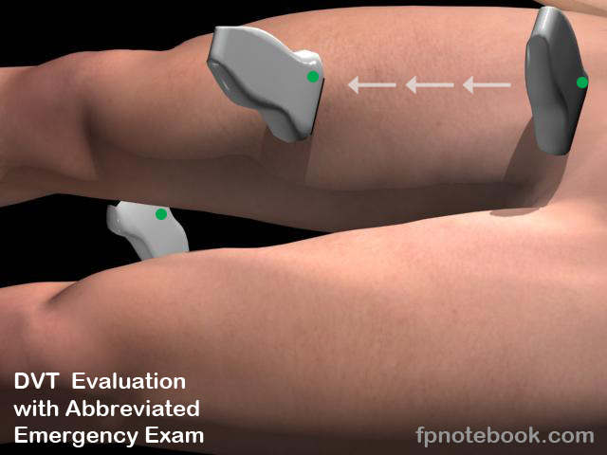
Patient Positioning for DVT POCUS

Slide 6
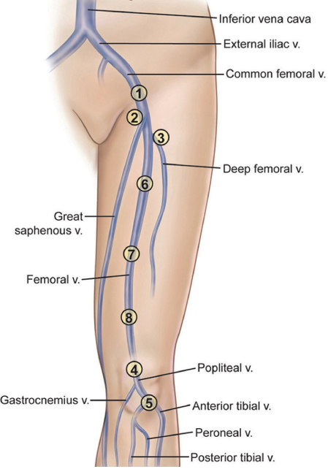
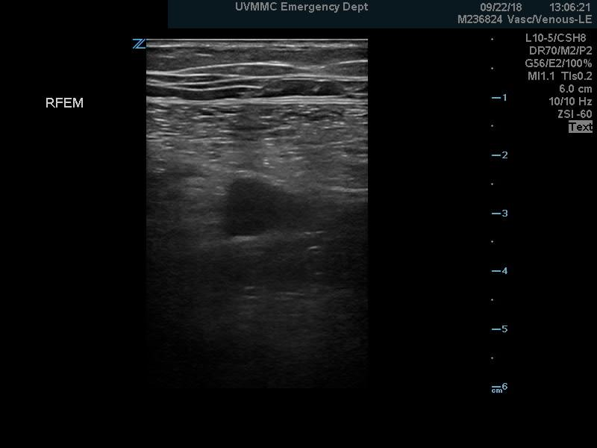
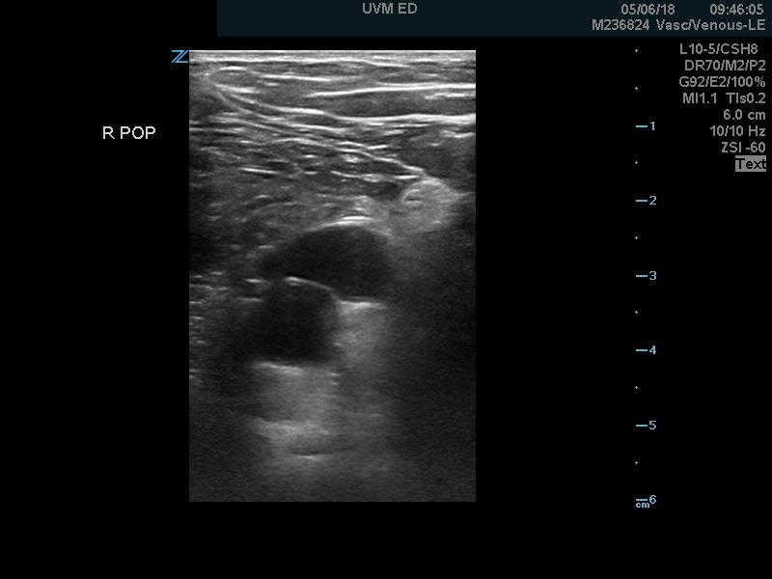
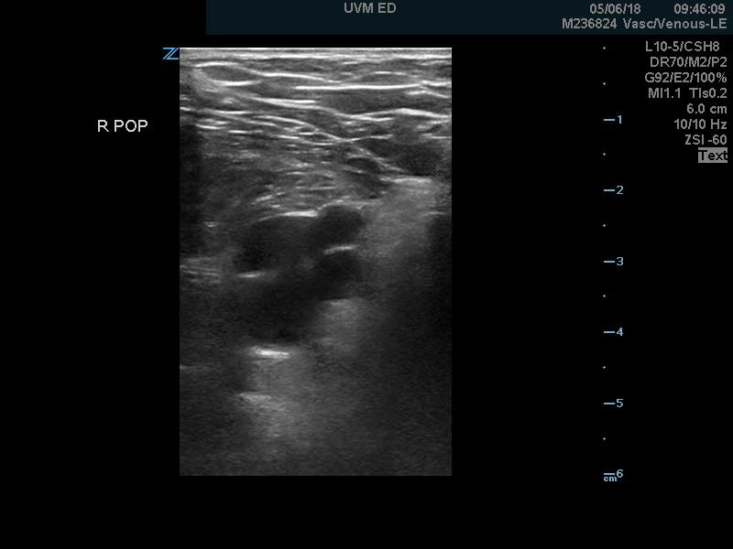
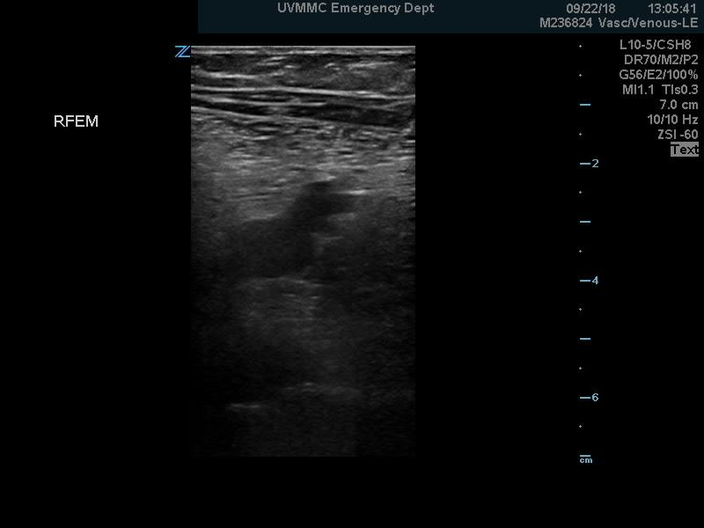
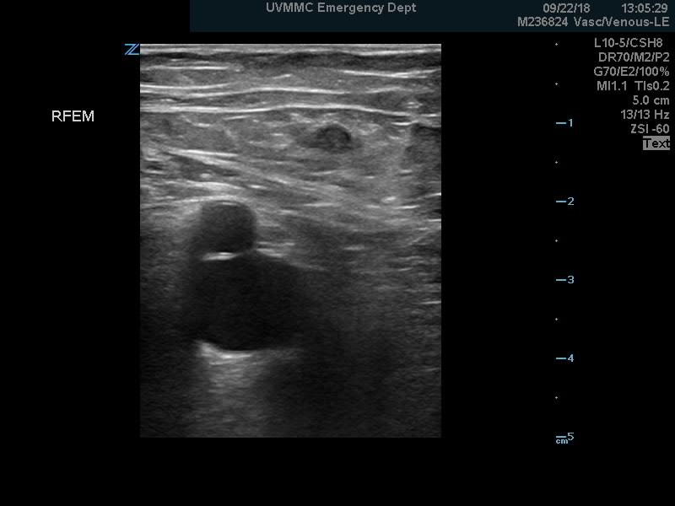
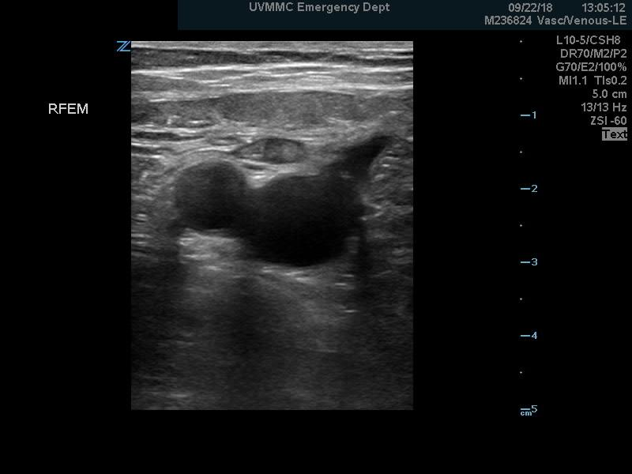
Normal Anatomy
GSV
FV
CFA
FA
PV
V
V
CFV
FV
FV
FV
V
PA
PA
DFV

Slide 7
POCUS Evaluation for DVT

Slide 8
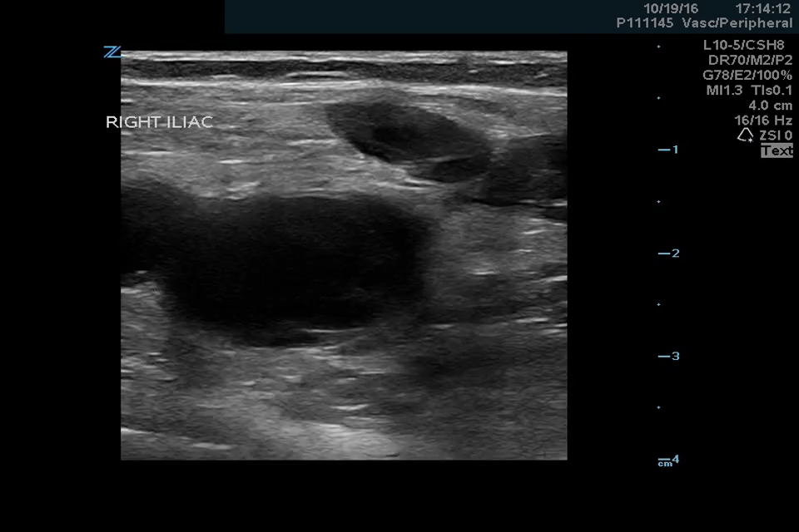
Pathology - DVT

Slide 9
DVT POCUS- Clinical Decision Making
DVT POCUS
TX
+
-
PP
LOW
HIGH
MOD
N/A
D-Dimer
COMP
+/- COMP

Slide 10
DVT POCUS- Cases

